Slide 1
PFD Assignment 2: FBEYE
Presented by: Team 1
Sponsored by: AIDC Group
Notes:
shane

Slide 2
Table of Contents
01
02
03
04
05
06
Introduction
First Iteration
Second Iteration
Third Iteration
Differences
Product Demo
Notes:
shane

Slide 3
01
Introduction
Notes:
shane

Slide 4
Problem Statement
How would the data from some of these examples be collected, collated, stored, retrieved, analysed and some value be derived for use by the industry?
How can this be done better, seamlessly and actively without user having to incorporate extra processes or steps?
How would end consumers make use of these data and chart better strategies moving forward?
Notes:
shane

Slide 5

An innovative solution designed for enhanced attendance management for AIDC employees which streamlines the attendance process but also significantly enhance security and accountability.
Notes:
shane

Slide 6
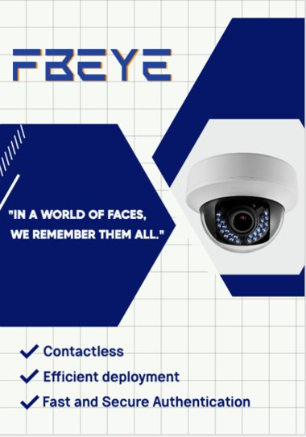
Notes:
shane

Slide 7
02
First Iteration
Notes:
sharon

Slide 8
Features done:
UI of Employee Attendance ✔
(no linkage to Firebase)
UI of Employer Attendance ✔
(no linkage to Firebase)
UI of Upload Photo Page ✔
(no linkage to Firebase)
Apply MC/Leave Page ✔
Detection of Face (Open Camera) ✔
Notes:
sharon

Slide 9
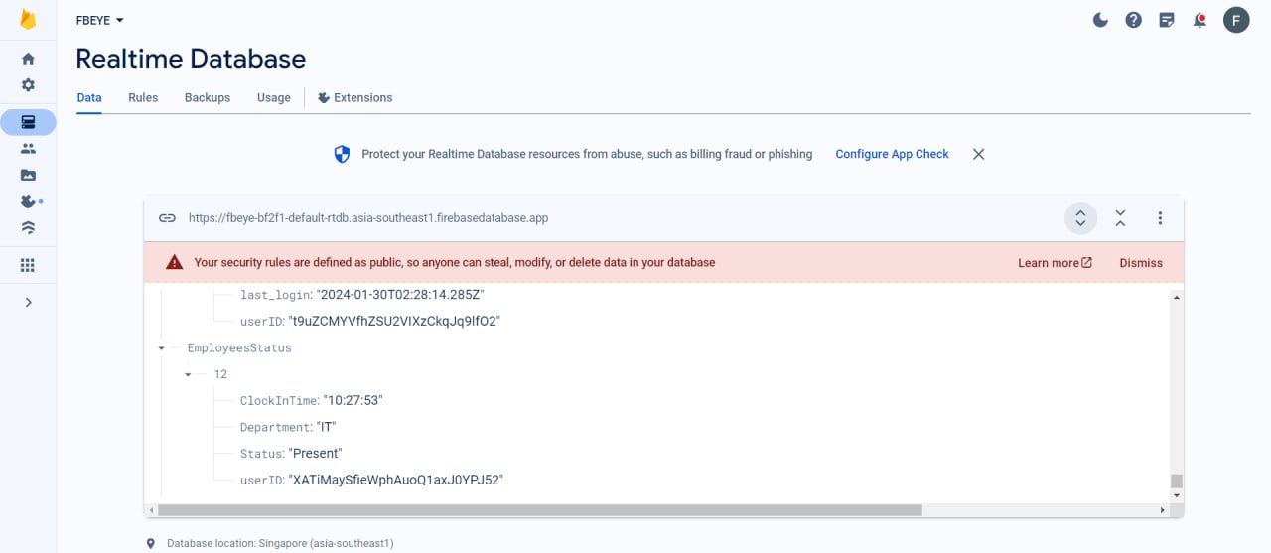
Notes:
sharon

Slide 10
Recap from Hackathon
Notes:
sharon

Slide 11
Problems During Hackathon
Spent more time on the user interface, back end code was caught lacking
Could not debug all the code on time
Presentation was messy
Database was too complicated and difficult to maintain
Did not make use of the data collected
Notes:
sharon

Slide 12
03
Second Iteration
Notes:
charmaine

Slide 13
Features done:
Sessions for Users ✔
Employee Attendance linked ✔
Employer Attendance linked ✔
Upload Photo (to Firebase)
Recognise Faces ✔
Get Photos from Firebase ✔
Update database and store relevant data ✔
Notes:
charmaine

Slide 14
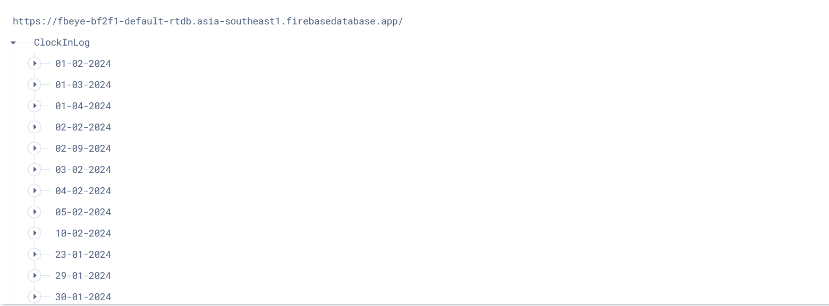
Notes:
charmaine

Slide 15
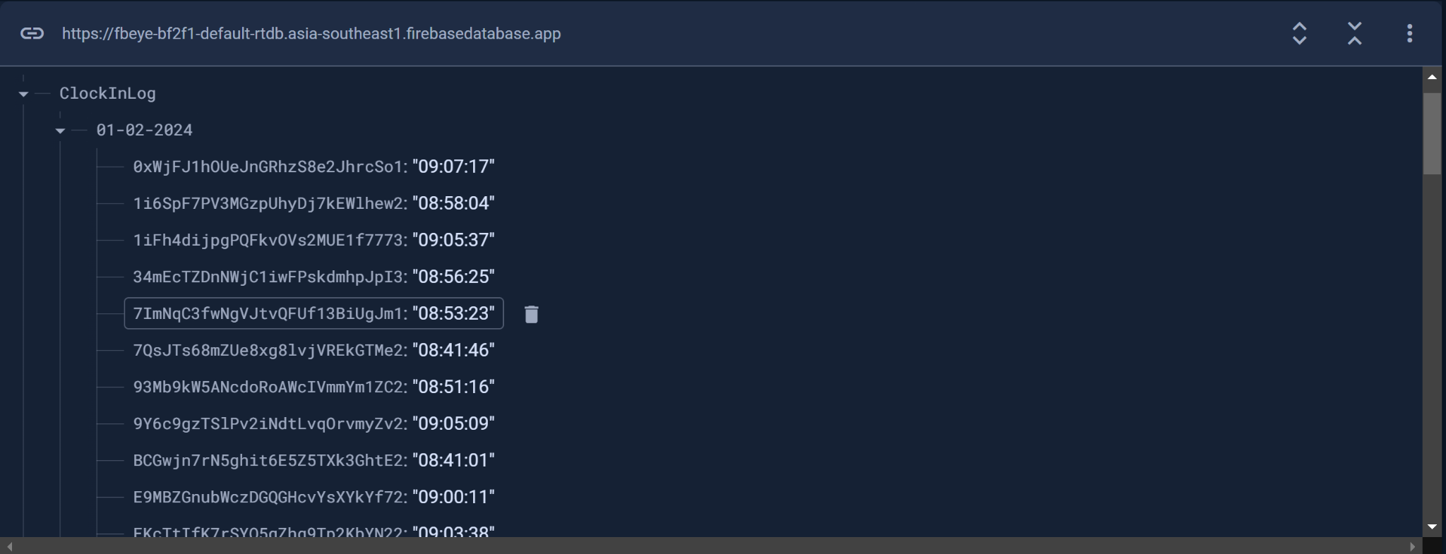

Slide 16
04
Third Iteration
Notes:
Vin Hee

Slide 17
Feedback Given:
Database structure is messy
Apply Leave needs an upload photo function to provide proof
Implement an Administrator Account for the website
The user interface design was good
Notes:
Vin Hee

Slide 18
Features done:
Fixed Database Structure ✔
More Data Added ✔
Upload Photo feature added for Submit MC Page ✔
Administrator Account ✔
FBeye App ✔
Dashboard for Employee Statistics ✔
Employee/Employer View of MC Status (Approved/Pending) ✔
Notes:
Vin Hee
- fix structure of database to make it neater
- added more employees
- added upload mc photo function in applyLeave.html
- creation of another view - Administrator View, 1) add employee 2) update employee record 3) look through leave summary request details including image of MC, can approve or reject leave
- in attendanceE view there is mc summary so that they able to see their leave request being approved or not, added the submit mc button on top right
- In the attendance summary manage to update the status mc/leave if they have already submitted request and is approved

Slide 19
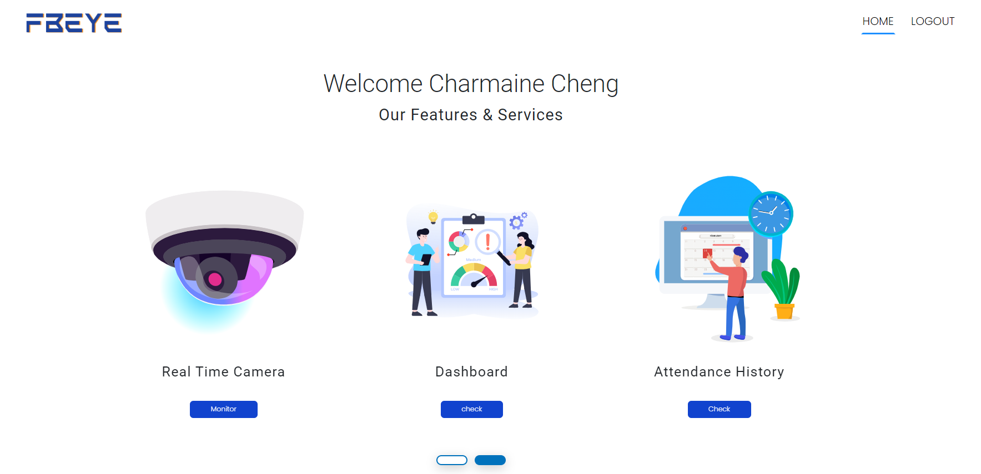
Notes:
Vin Hee

Slide 20
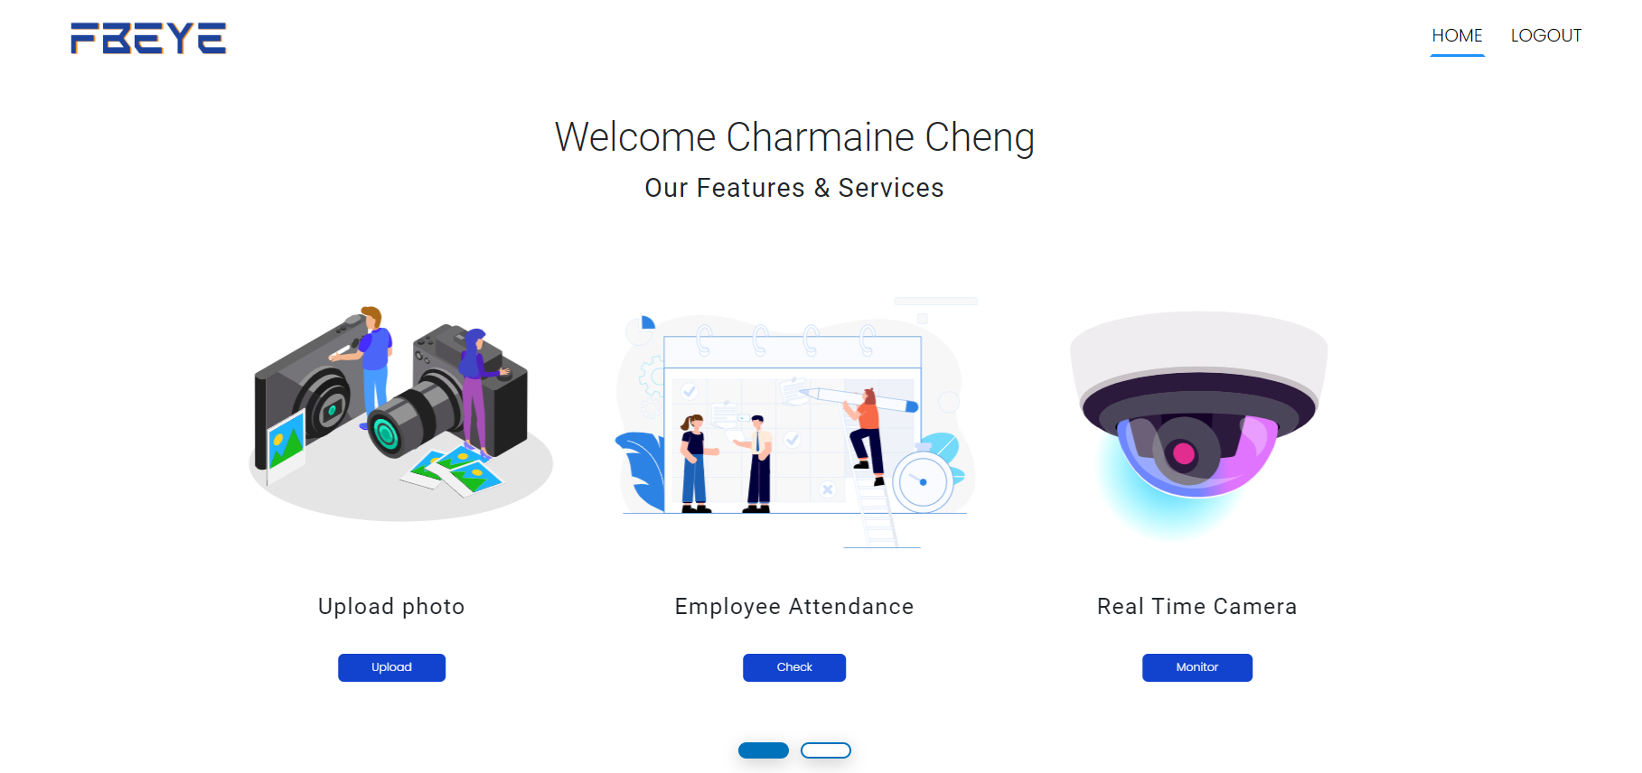
Notes:
Vin Hee

Slide 21
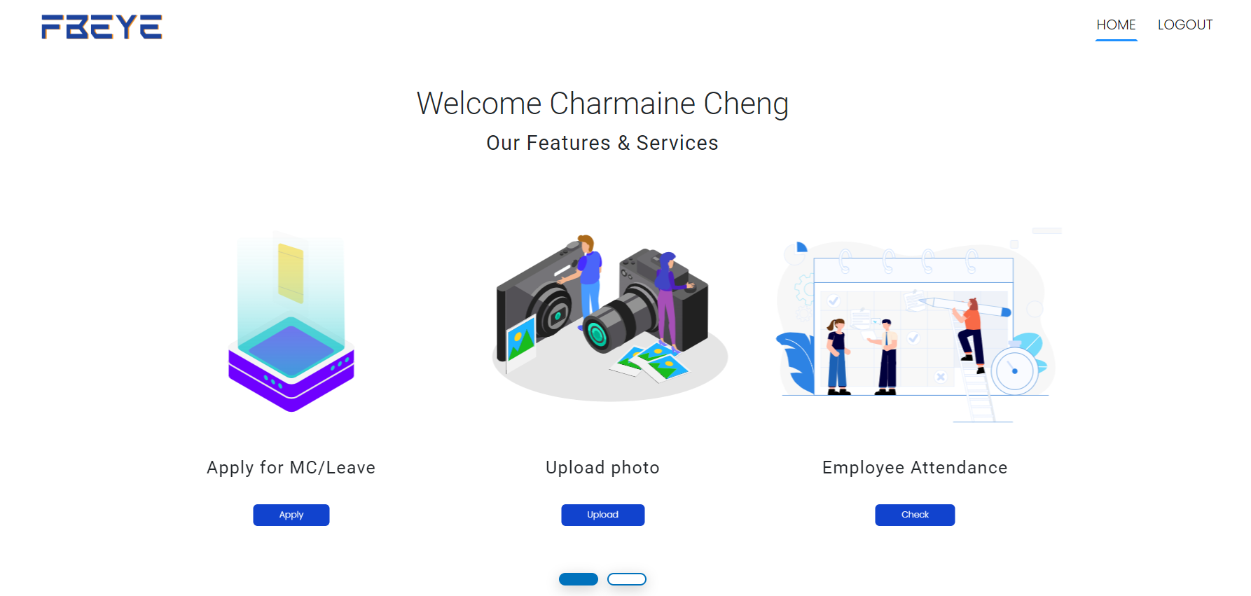
Notes:
Vin Hee

Slide 22
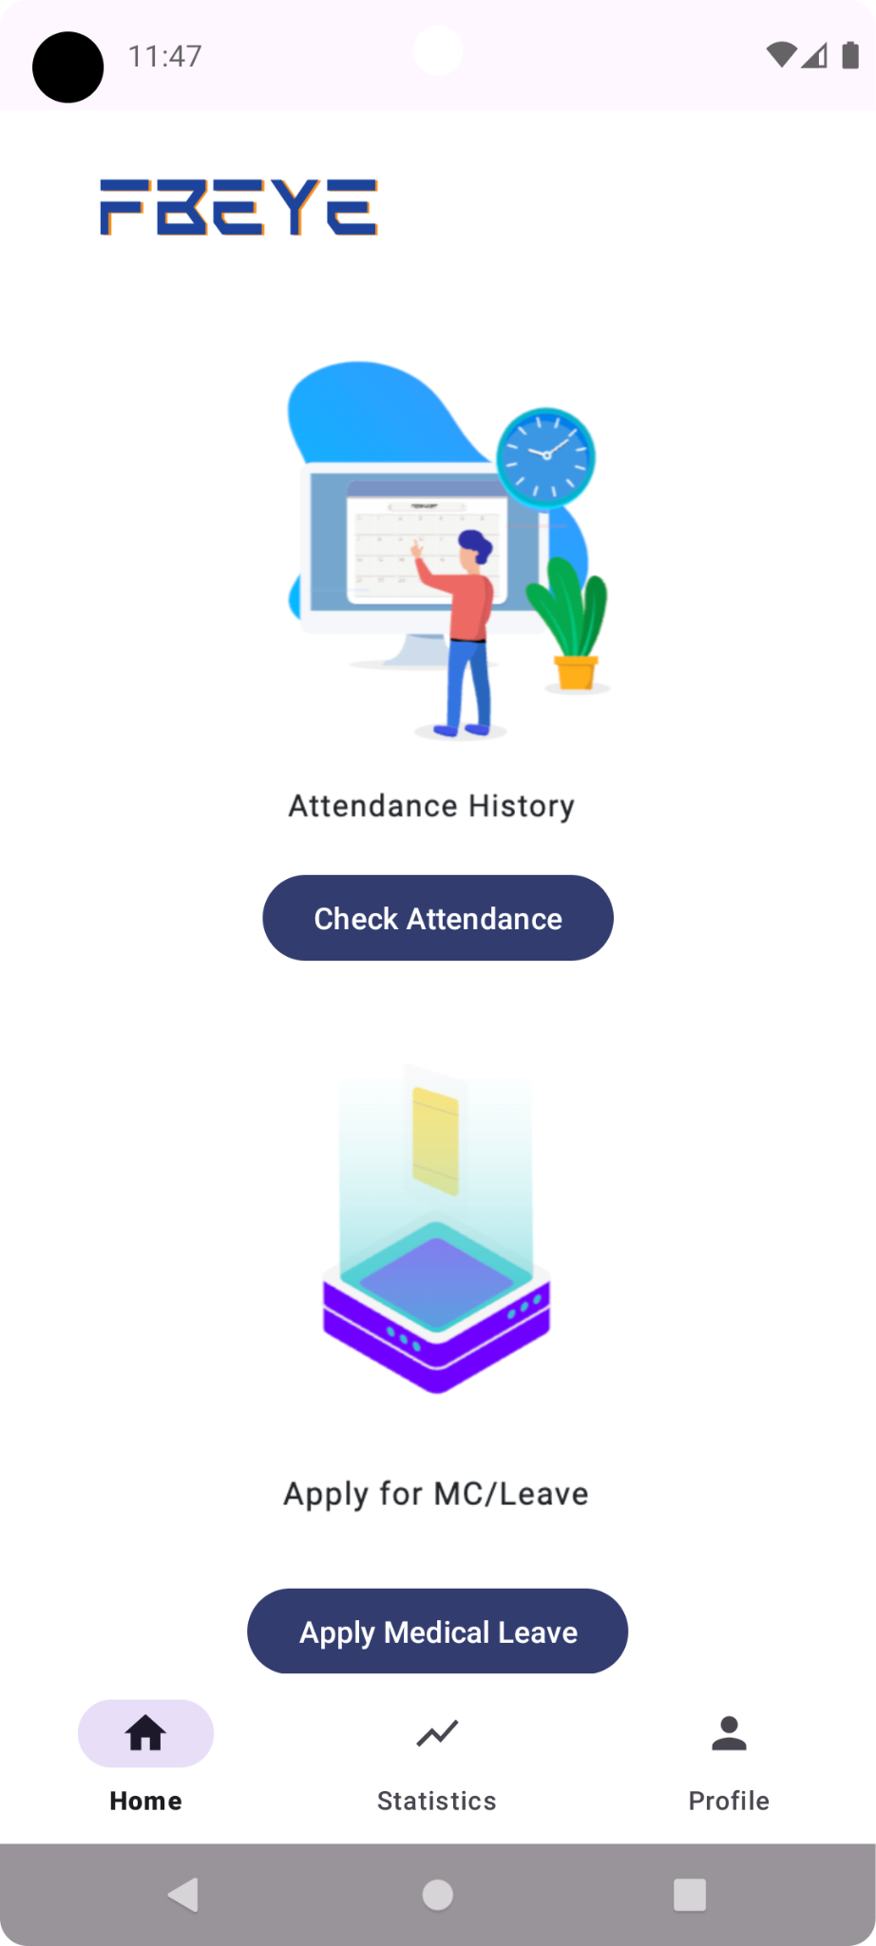
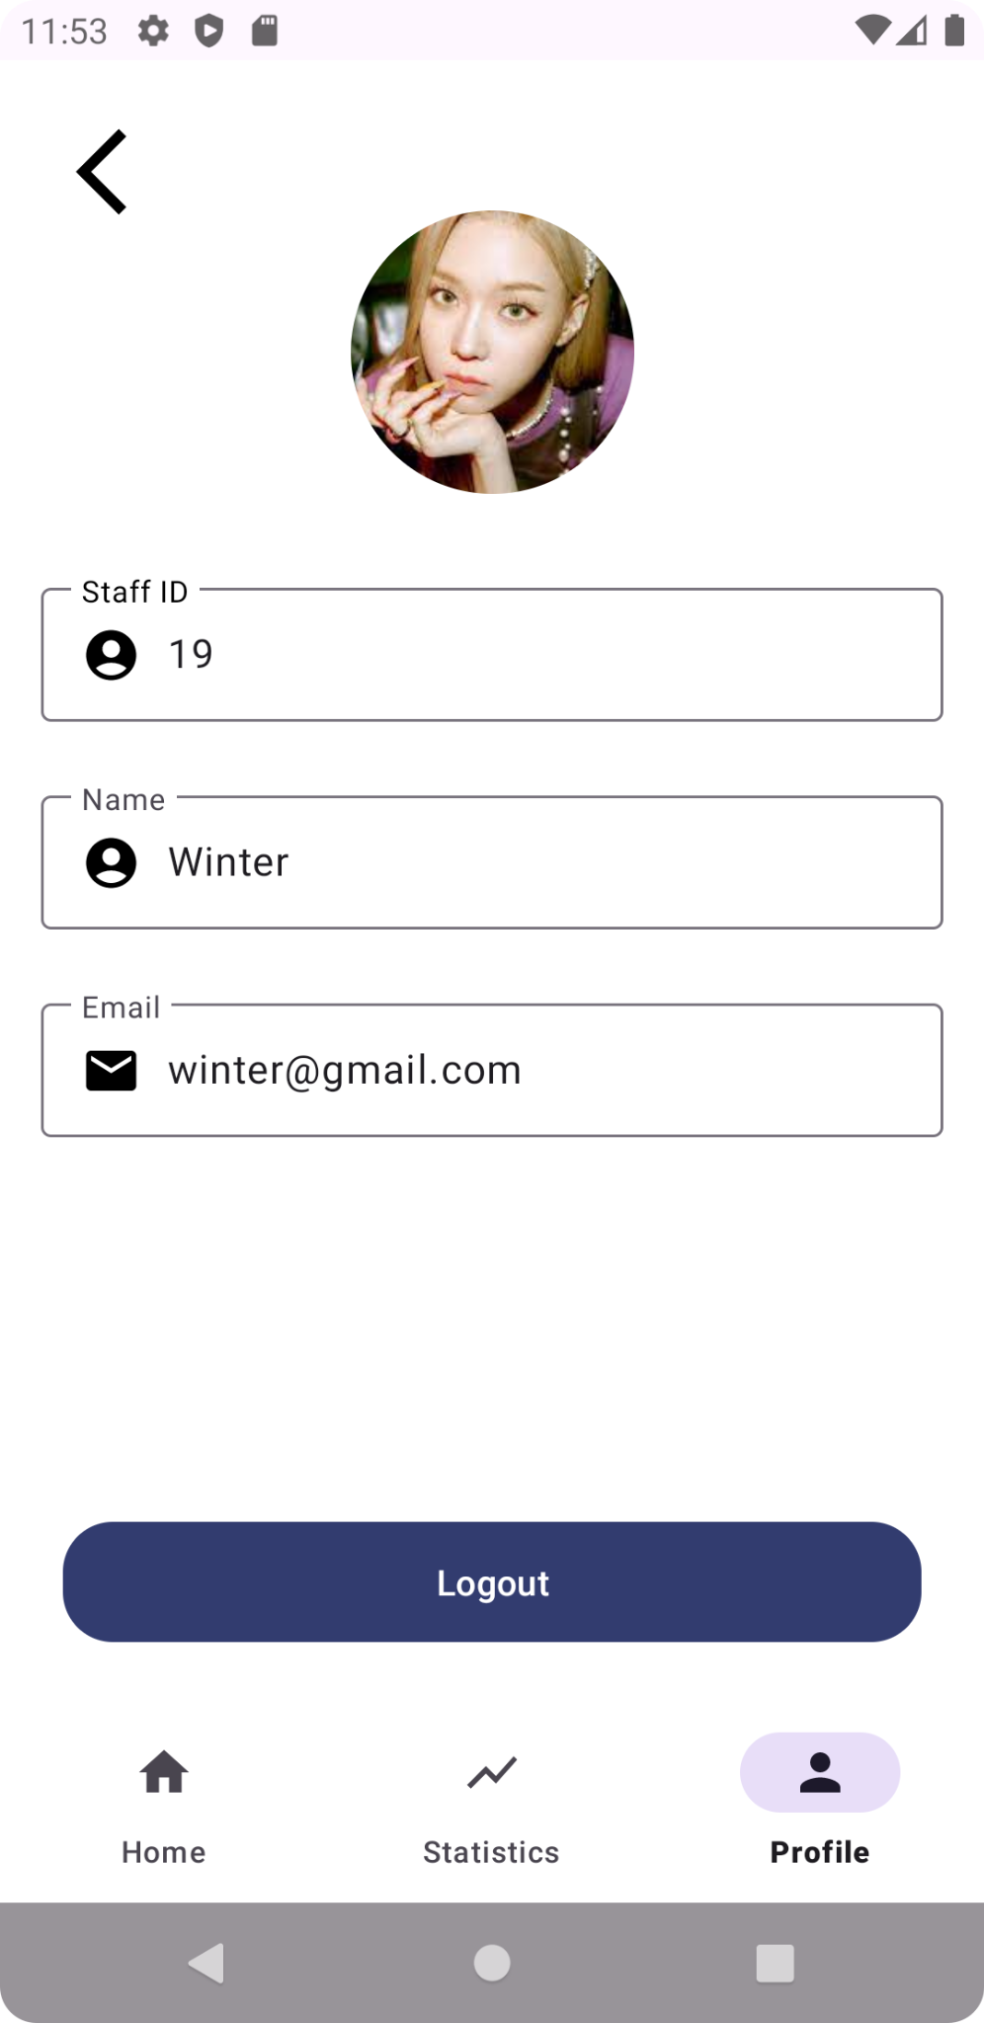
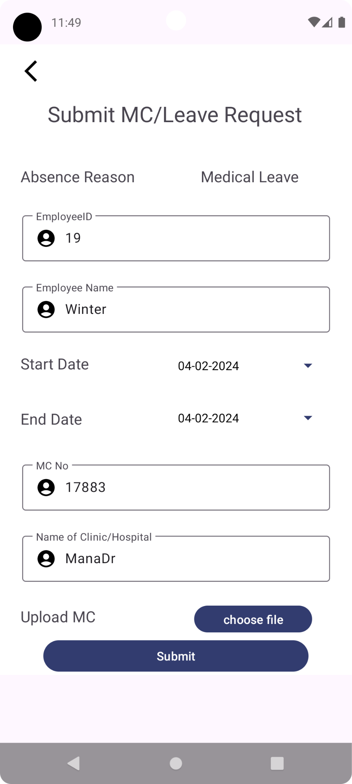
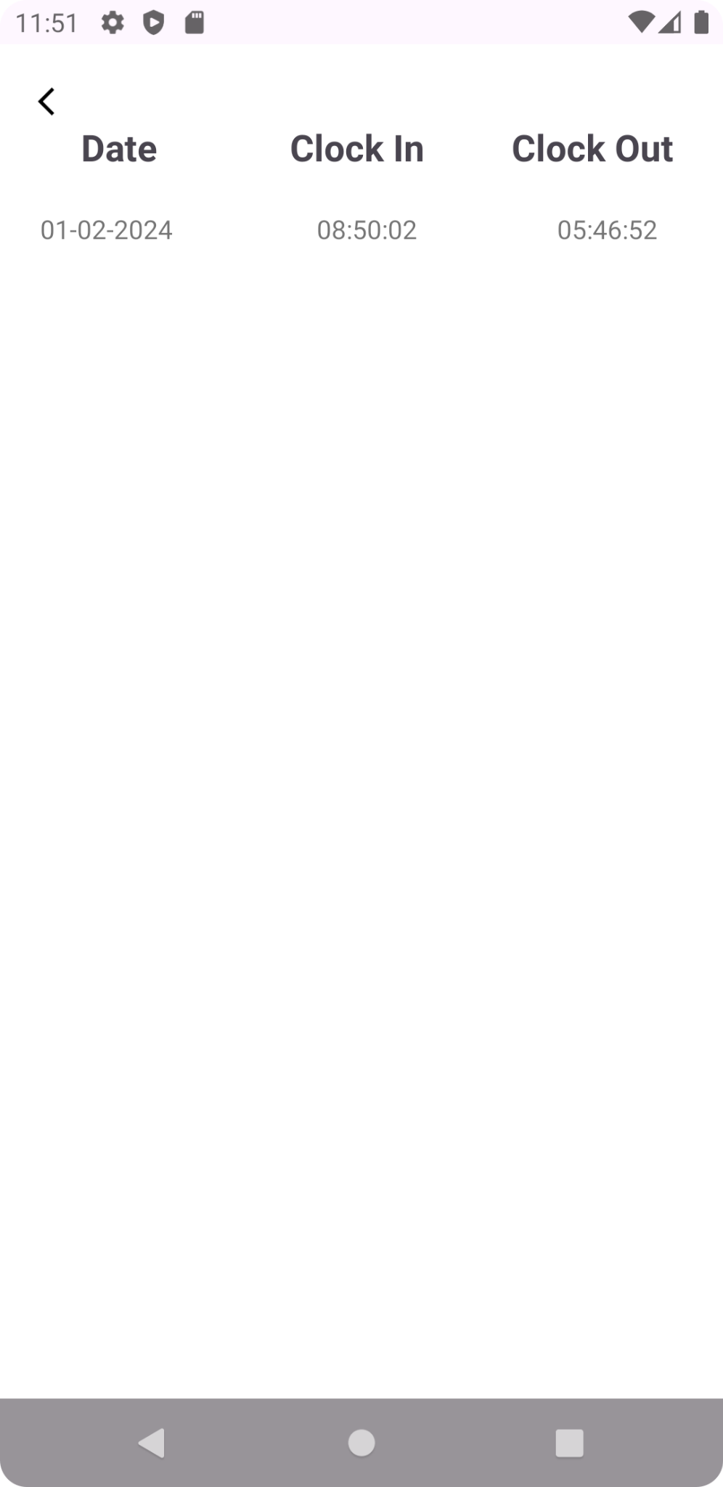
Notes:
Vin Hee

Slide 23
05
Differences
Notes:
shane

Slide 24
Differences Between First and Second Iteration
First Iteration
Second Iteration
Focused more on UI of the website
Messy database
Basic increments
Inefficient backend
More consistent and precise database
Emphasis on data collection
More user-friendly
Optimised and debugged backend

Slide 25
06
Project Demo
Notes:
1st charmaine,sharon 2nd vinhee,sharon

Slide 26
References
ChatGPT: To Solve Code Bugs
Streamlit
Flask
Firebase
Android Studio
Visual Studio Code (Javascript & HTML)
Python
Google Sheets
Notes:
vinhee

Slide 27
Thank You!
Notes:
vinhee

Slide 28
Thanks!
Do you have any questions?
youremail@freepik.com
+34 654 321 432
yourwebsite.com
Please keep this slide for attribution

